Slide 1
Customer Satisfaction Prediction Project
Created by: Divya Krishnakumar
Type of project: Internship Project
Submitted to: Unified Mentor Pvt Ltd.
Date: 21/07/2025

Slide 2
Executive Summary
The Customer Satisfaction Prediction project aims to analyse and predict customer satisfaction resulting from resolution of various issues generated by different tech products over a certain period of time. The customer support dataset provided for the analysis and prediction of customer satisfaction contained the data about the tickets raised on the technical issues of the products purchased in the past. The dataset consisted of 8469 rows and 17 columns. Some of the columns were Ticket ID, Ticket Type, Product Purchased, Date of purchase, Customer Name, Customer Email, Customer Age, Customer Gender, Ticket Subject, Ticket Description, Ticket Status, First Response Time, Customer Satisfaction Rating. The Customer Satisfaction Rating ranges for closed tickets ranges from 1 to 5.
The methodology followed here involves the following steps such as Data Collection, Data wrangling, Feature Engineering, Data Analysis and Visualisation, Modelling, Evaluation. The required libraries are imported. The data is loaded to a data frame from the customer_support_tickets.csv file. The descriptive statistics is performed on data. The categorical columns are label encoded. Then the data set is checked for any null values. The null values in the categorical columns are replaced with constants and null values in the numerical columns are replaced with 0. The columns are renamed to relevant names. The datetime columns which were in object data type were converted to datetime types. The data is analysed with SQL and insights such as names and number of customers who are most satisfied with the resolution, number of different priority issues, number of priority issues raised from different channels and so on. The data is analysed and visualised with Python libraries and insights are displayed. The insights were customer segmentation by ticket types, ticket types of various priorities, the top 10 products that raises the issues most and so on. For each insight visualisation is displayed using pie chart, count plot, hist plot etc. Correlation analysis is done to find out correlation among features and the correlation among features is displayed using a bar plot.
Model is developed using RandomForestClassifier machine learning algorithm, stratifiedKFold cross validation is done and hyperparameters tuned using GridSearchCV. Predicted the unseen data and a classification report is generated which displayed the metrics precision, recall and f1 score, accuracy. The confusion matrix is plotted for multi class prediction.

Slide 3
Introduction
The aim of the project is to predict Customer Satisfaction using the given historical data. This involves analyse the cutomer_support_ticket dataset to find the factors that influence Customer Satisfaction and build a predictive model.
The key questions are:
Which ticket type is most frequently raised?
What are the top 10 common issues?
What is the relationship between ticket type and priority?
What is the duration between first response time and time to resolution?
What is the channel that customers use most of the time to raise the issues?
What is the gender that raises the ticket most?
What is the age group that raises the ticket most?
Which is the Customer Rating most rated by customers?

Slide 4
Methodology
The data is collected from the site provided.
The methodology consisted of the following steps - as Data Collection, Data wrangling, Feature Engineering, Data Analysis and Visualisation, Modelling, Evaluation.
The collected data is cleaned, analysed, visualised and subjected to machine learning algorithms such as Random Forest Classifier, Logistic Regression and evaluated.
Data Collection – Data is collected and loaded to a data frame. The columns of the data frame include Ticket ID, Ticket Type, Product Purchased, Date of purchase, Customer Name, Customer Email, Customer Age, Customer Gender, Ticket Subject, Ticket Description, Ticket Status, First Response Time, Customer Satisfaction Rating.

Slide 5
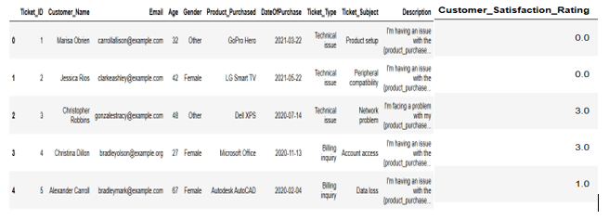
Data Wrangling
Data Wrangling – The columns are renamed to relevant names. The data set is checked for null values. The null values were there in the columns Resolution, First Response Time, Time To Resolution and Customer Satisfaction Rating columns. The null values were present in these columns because of resolution had not taken place and thus no Customer Satisfaction Rating or resolution has taken place but customer has not responded for these tickets which were not closed. To make the analysis and visualisations better the null values in the columns Resolution, First Response Time, Time To Resolution the null values were substituted with ‘Unknown’ and in the column Customer Satisfaction Rating the null values were substituted with 0.0 which shows the rating not available. The First Response Time, Time To Resolution columns were converted from object type to datetime type.
The data frame thus obtained was as follows:-

Slide 6
Feature Engineering
The categorical features are label encoded to numerical to enable them for machine learning.
From FirstResponseDate and FirstResponseTime Date and Time are extracted to two separate columns. From ResolutionTime Data and Time are extracted to two separate columns.
A new feature Time_Elapsed_to_respond_seconds is created which gives the time elapsed to resolve the issue in seconds

Slide 7
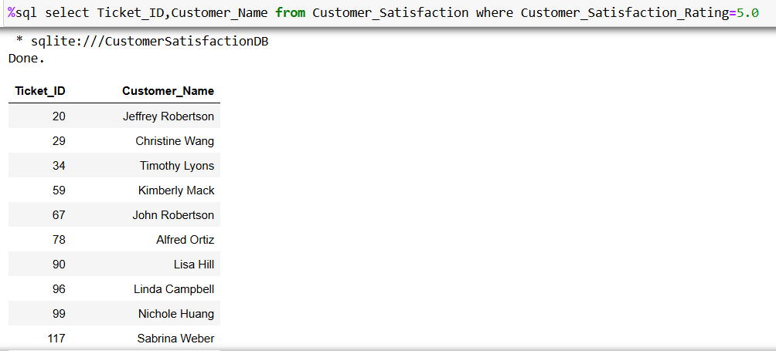
Data Analysis with SQL Results
Ticket_ID and Customer names of most satisfied customers

Slide 8
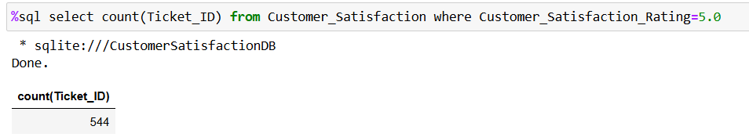
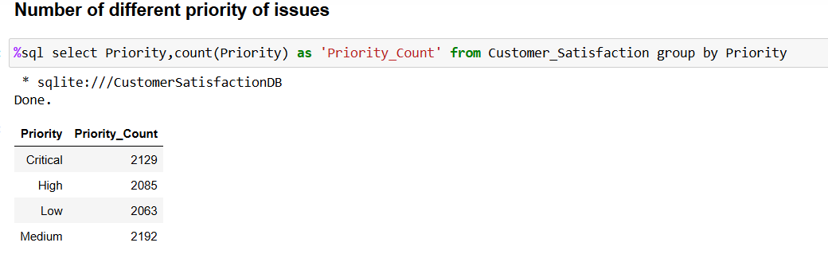
Data Analysis with SQL Results
Number of customers who are most satisfied with the resolution

Slide 9
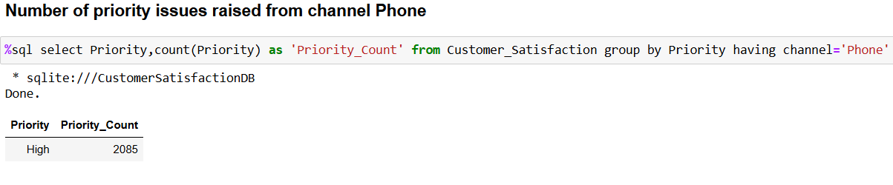
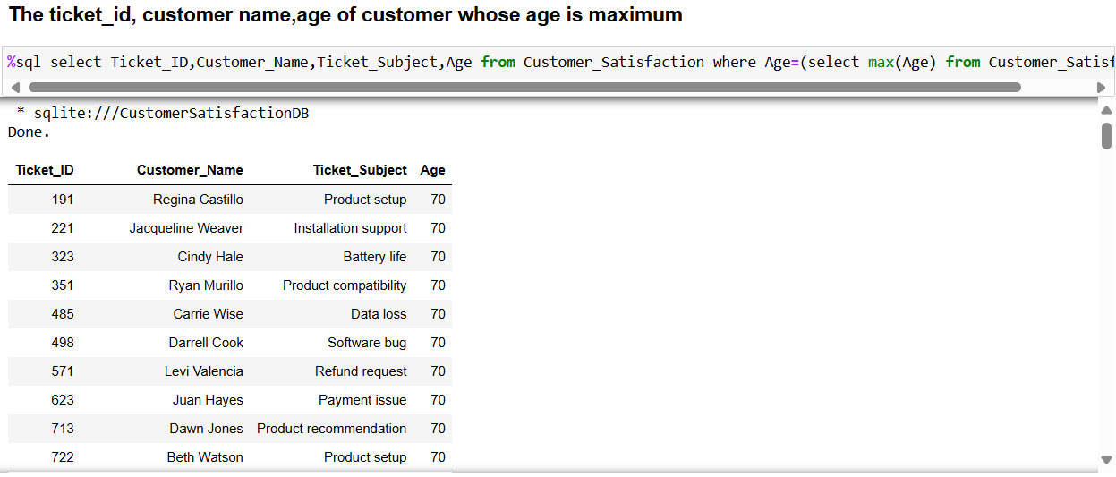
Data Analysis with SQL Results

Slide 10
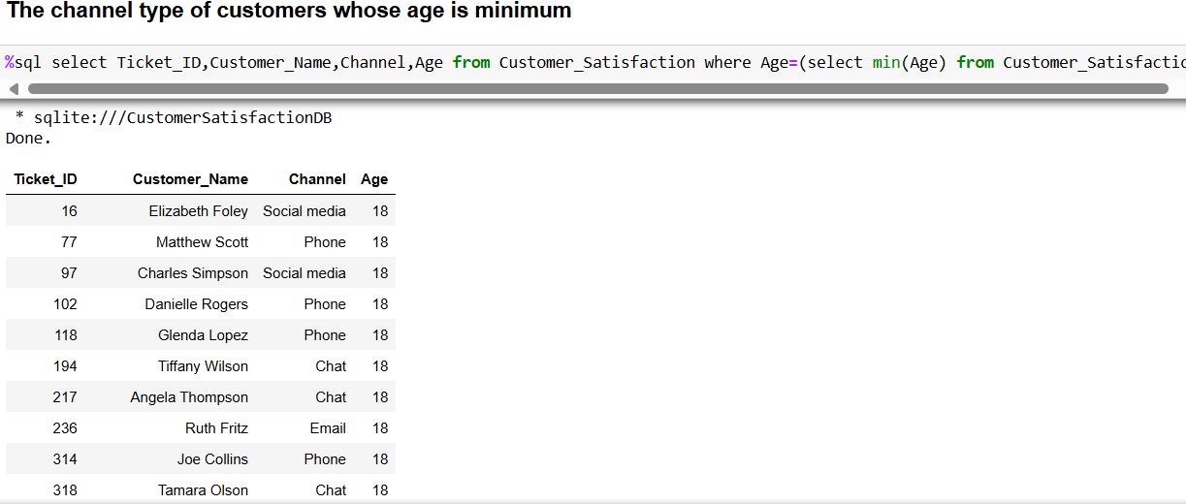
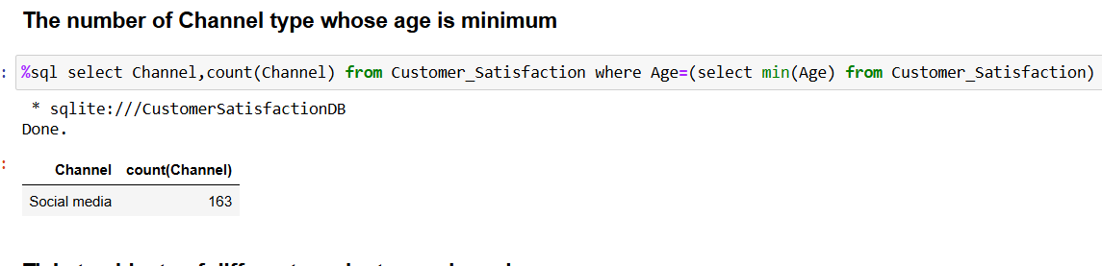
Data Analysis with SQL Results

Slide 11
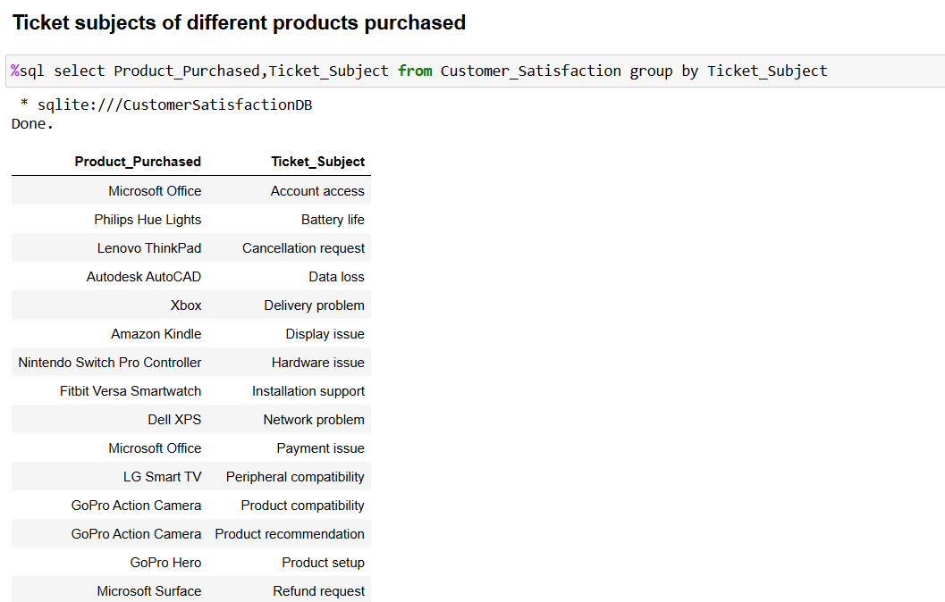
Data Analysis with SQL Results

Slide 12
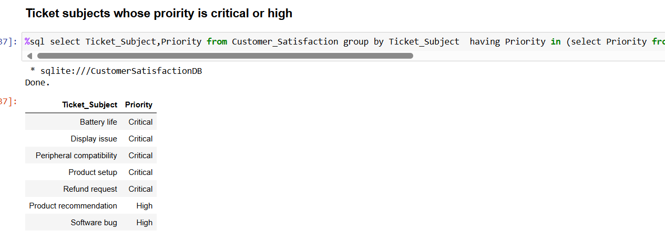
Data Analysis with SQL Results

Slide 13
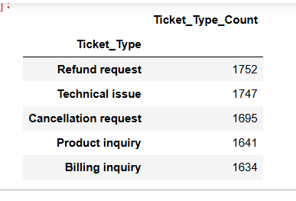
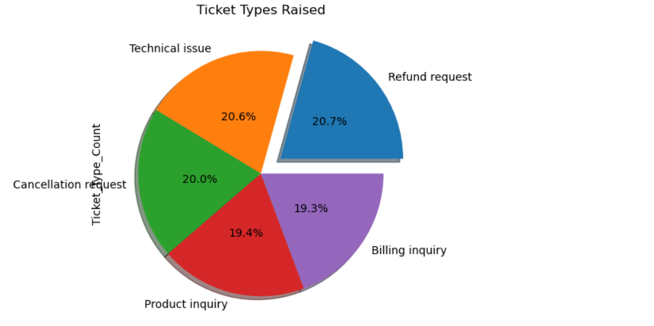
Exploratory Data Analysis(EDA) and visualisation results
Which ticket type is most frequently raised?-Customer Segmentation by ticket types

Slide 14
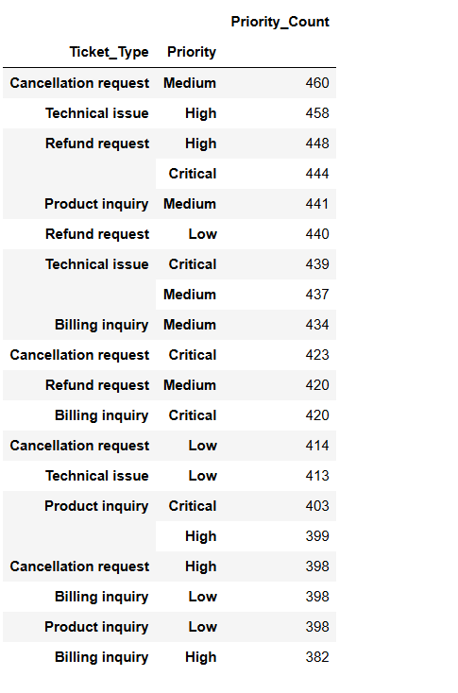
Exploratory Data Analysis(EDA) and visualisation results
Relationship between ticket type and priority

Slide 15
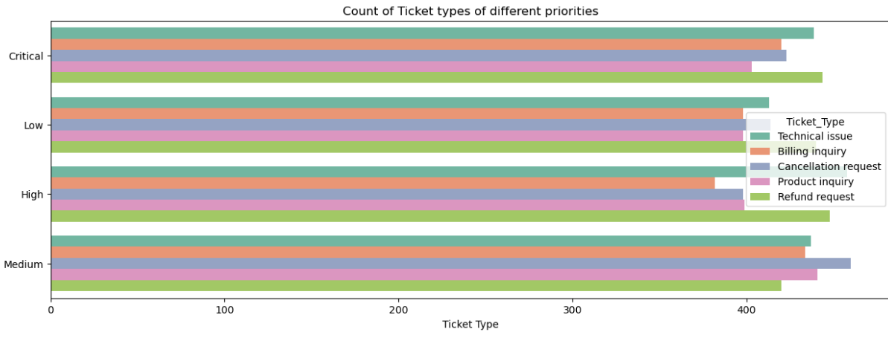
Exploratory Data Analysis(EDA) and visualisation results
A count plot is plotted to visualize count of ticket types of different priorities

Slide 16
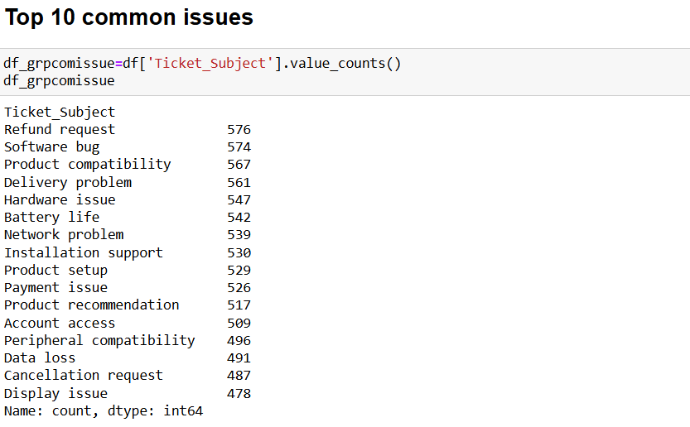
Exploratory Data Analysis(EDA) and visualisation results

Slide 17
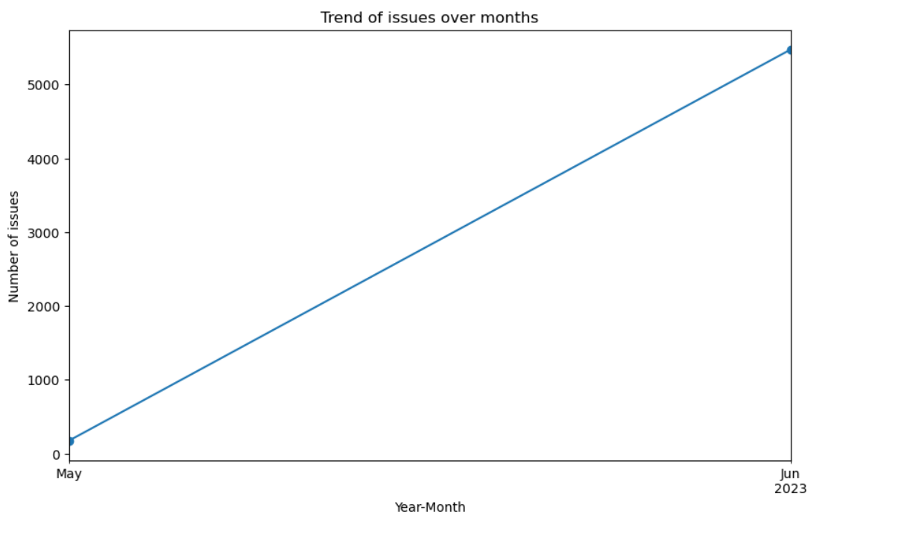
Exploratory Data Analysis(EDA) and visualisation results
Trends of issues over the years

Slide 18
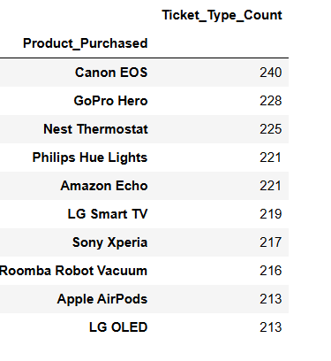
Exploratory Data Analysis(EDA) and visualisation results
Which 10 products raises issues most?

Slide 19
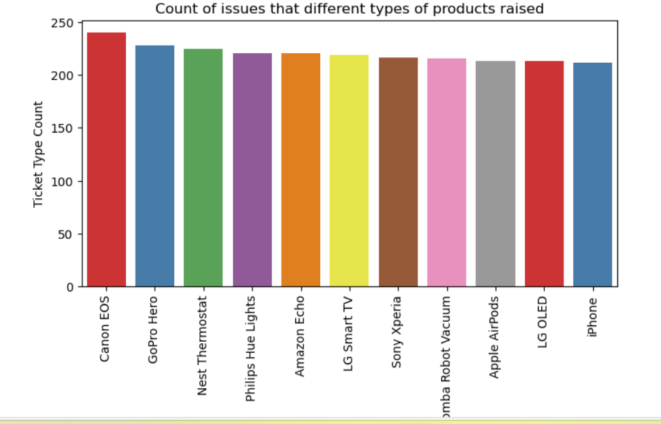
Exploratory Data Analysis(EDA) and visualisation results
A bar plot is plotted to visualize the count of issues that different types of products raised.

Slide 20
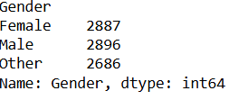
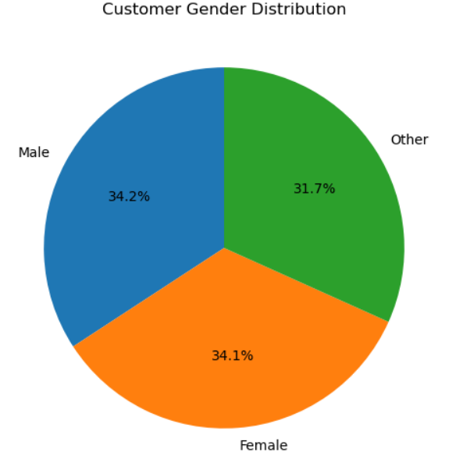
Exploratory Data Analysis(EDA) and visualisation results
The gender that raises ticket most
A pie chart is plotted to depict gender distribution.

Slide 21
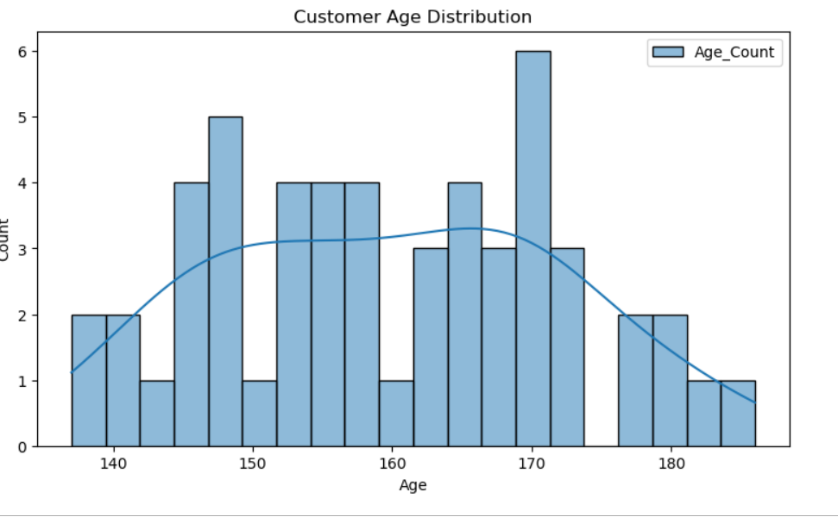
Exploratory Data Analysis(EDA) and visualisation results
The age group that raises the ticket most

Slide 22
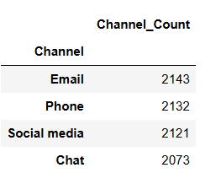
Exploratory Data Analysis(EDA) and visualisation results
The channel that customers use to raise the ticket most of the time

Slide 23
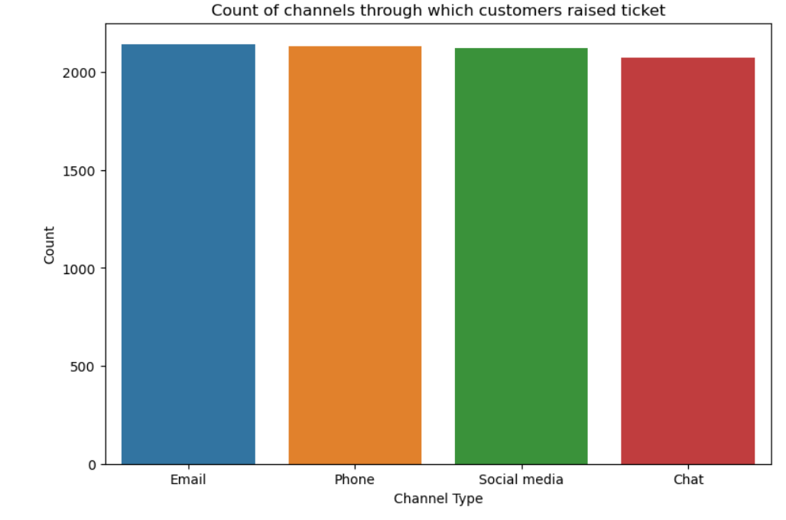
Exploratory Data Analysis(EDA) and visualisation results
A count plot is plotted to depict the channel that customers use to raise the ticket most of the time.

Slide 24
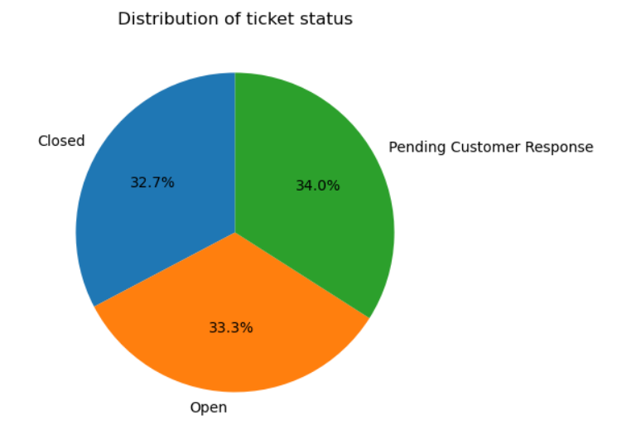
Exploratory Data Analysis(EDA) and visualisation results
Distribution of ticket status

Slide 25
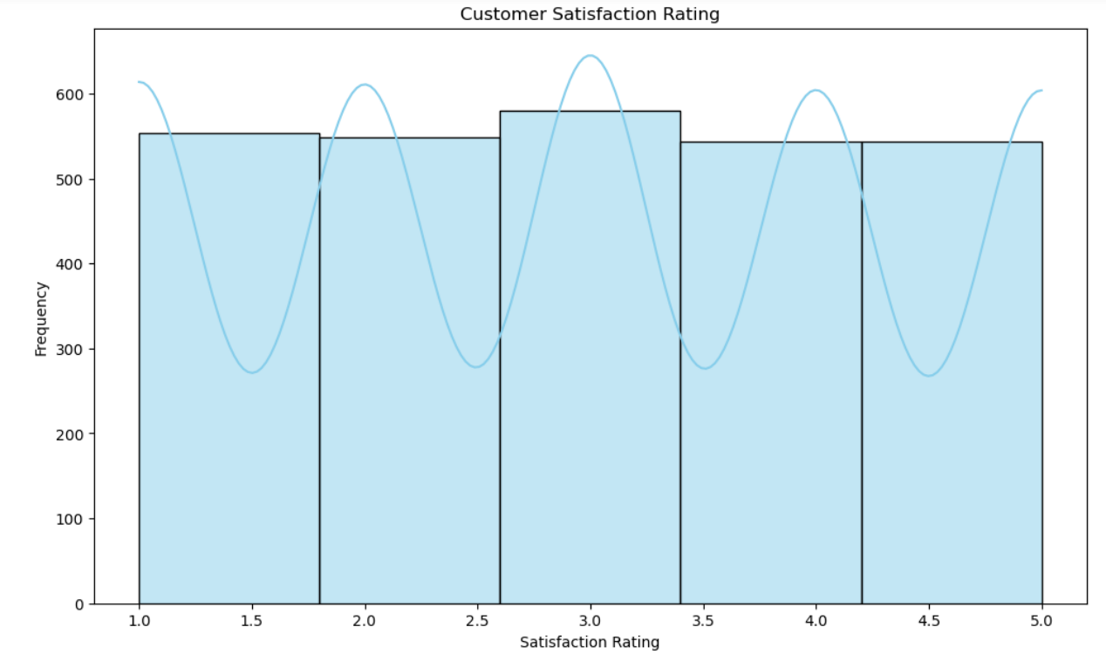
Exploratory Data Analysis(EDA) and visualisation results
Customer Satisfaction Rating

Slide 26
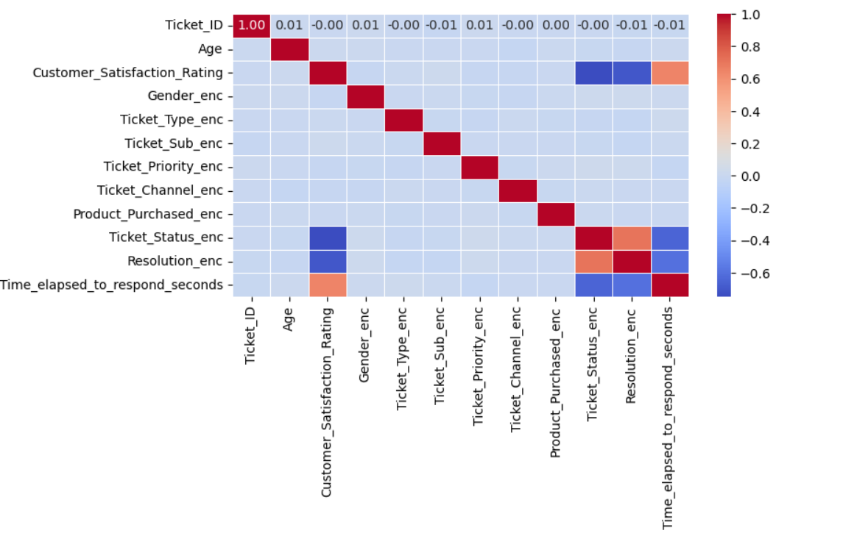
Exploratory Data Analysis(EDA) and visualisation results
Correlation analysis is done and a heat map plotted to identify correlation between variables.

Slide 27
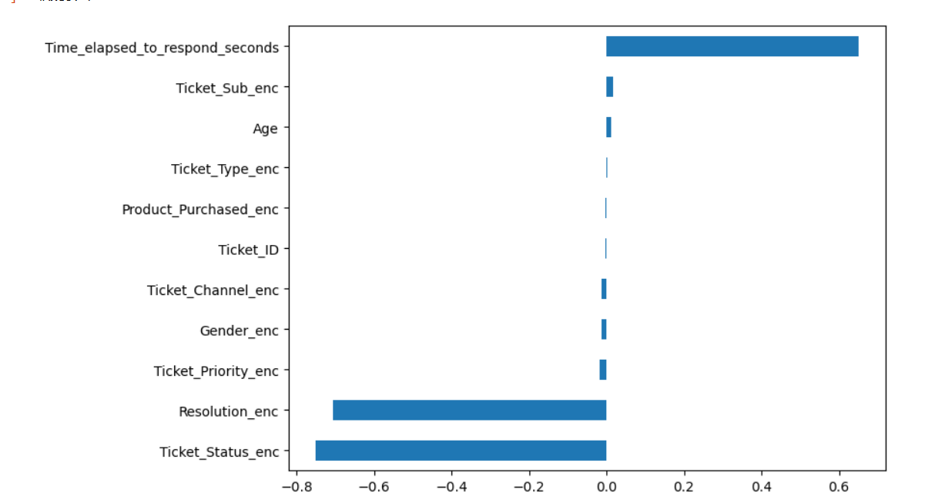
Exploratory Data Analysis(EDA) and visualisation results
A horizontal bar graph is plotted to visualise positive and negative correlation. Time elapsed to respond, ticket subject, age are positively correlated to customer satisfaction.

Slide 28
Modelling and predictive analysis
The data is subjected to machine learning algorithms such as RandomForestClassifier and Logistic Regression for multi class prediction. These models are fitted on training data and results are predicted.
RandomForestClassifier:- RandomForestClassifier object is created, hyperparameters are tuned with GridSearchCV and stratifiedKFold cross validation is done. The model thus is fitted with training data and after that the results are predicted.
As a part of evaluation a classification report is generated. A confusion matrix display is visualised.
Logistic Regression(One Vs All) for multi class classification- Logistic Regression one vs all model is created and fitted with training data and the results are predicted on unseen data.
As a part of evaluation a classification report is generated. A confusion matrix display is visualised.

Slide 29
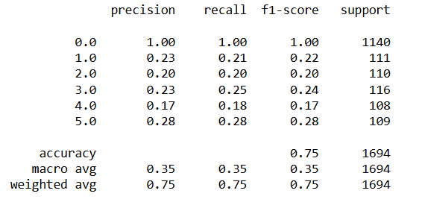
Modelling classification models-Results
Random Forest Classifier- Accuracy score is 74.55%
Classification Report

Slide 30
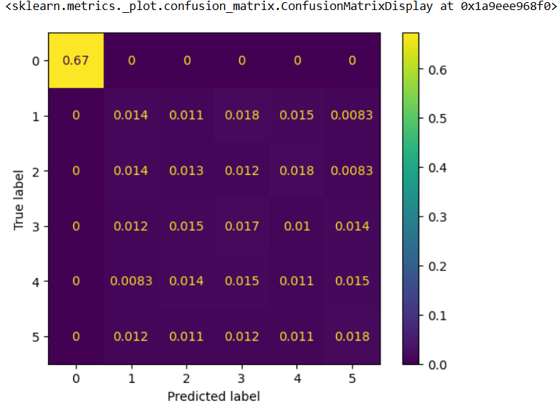
Modelling classification models-Results
Random Forest Classifier- Normalised Confusion Matrix Display

Slide 31
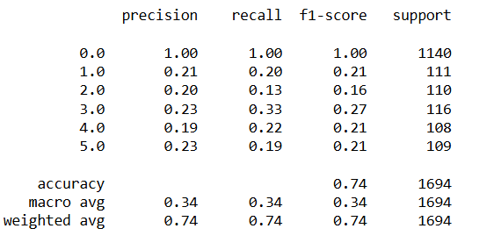
Modelling classification models-Results
Logistic Regression – Accuracy score of 74%

Slide 32
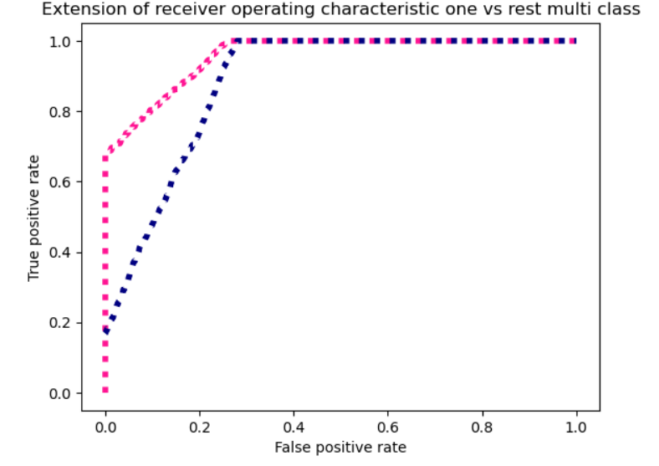
Modelling classification models-Results
Logistic Regression –
Micro averaged One-vs-Rest ROC AUC score :
Macro averaged One-vs-Rest ROC AUC score :
0.958
0.885

Slide 33
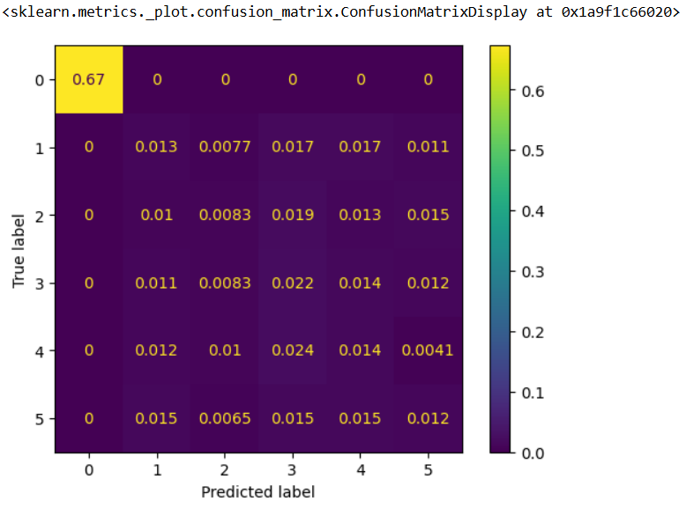
Modelling classification models-Results
Logistic Regression- Normalised Confusion Matrix Display

Slide 34
Findings and Implications
The people of the ages 44,34,48,52 raised tickets most.
The customer satisfaction rating of 3.0 was given by most of the customers about 580 of them.
The customers who use Email as the channel for raising tickets was high about 2143 customers use Email as channel to raise the tickets.
The product Canon EOS raised highest number of issues of about 240.
Number of cancellation requests with medium priority is greatest with 460 of them. Number of billing inquiry with high priority is lowest with 382 of them.
Technical issue raised was 20.6%, Refund request raised was 20.7%, and cancellation request raised was 20%.
The issues such as battery life, display issue, peripheral compatibility, product set up, and refund request were of critical priority.
The number of critical priority issues was maximum with 2129.
The number of customers who gave a customer satisfaction rating of 5.0 was 544.

Slide 35
Conclusion
The different customer satisfaction ratings given by customers were almost equally distributed. The customer satisfaction rating was average for maximum number of issues. The issues had an increasing trend over the period. The customer satisfaction was high for issues that were resolved in least time. It also depends on ticket subject of critical priority. If ticket subjects of critical priority is resolved in least time then customer satisfaction will be high. The age of the customer also influences customer satisfaction since most of the issues were raised by older age groups.
Future implications and suggestions to improve customer satisfaction
To improve customer satisfaction the issues need to be resolved on priority wise and in least time.
The timeline of first response and resolution of different priority issues has to be fixed within a range.

